Slide 1
HW4 IOCTL
Professor: H. P. Chang
Tzu-Hsuan Liao
OSLab

Slide 2
Introduce

Slide 3
Readahead Introduction
HDD is the major bottleneck in computer system performance.
Access time = seek time + rotation latency + transfer time.
Seek time and rotation latency are overhead. Therefore, it's better to read more data each time to improve throughput.
Readahead —proactively read more data than the request need.
Readahead
Request size
HDD readahead
2 times
Notes:
Readahead 有改 overhead有改

Slide 4
blockdev --setra 256 /dev/sda1

Slide 5
Blockdev
blockdev --setra 256 /dev/sda1
blockdev - Call ioctls from the command line.
—setra 256 - Set readahead size to 256.
/dev/sda1 - device.

Slide 6
IOCTL

Slide 7
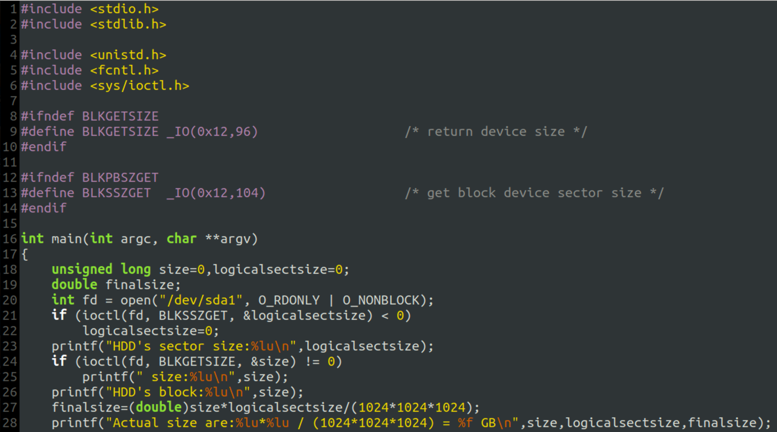
IOCTL
ioctl - a system call for device-specific input/output operations.
#include <sys/ioctl.h>
int ioctl(int fd, unsigned long request, …);
EX: BLKGETSIZE return total block.
BLKSSZGET return sector size.
ioctl(fd, BLKSSZGET, &logicalsectorsize)
ioctl(fd, BLKGETSIZE, &size)
fd=open("/dev/sda1", O_RDONLY | O_NONBLOCK).
printf("HDD's size:%lu”, logicalsectorsize)
printf("HDD's size:%lu”,size)

Slide 8
Homework
Using ioctl to change the readahead size.

Slide 9
Homework 4 ioctl
Write a c program using ioctl function to change the size of readahead.(The readahead size are:0,16,64)
Using HW1 to creates a 512MB file on your local disk and then measures the time of two different programs (Sequential read, Random read) by directly using system call I/O interface (read(),seek()…).
Comparing the times under different readahead sizes in sequential read and random read (What's the difference? Why?).
Tips: Check out the linux fs.h file.
Notes:
By using有改

Slide 10
Homework 4 ioctl
The homework you submit to iLearning 2.0 should be: student id_HW4.zip ex:7109056025_HW4.zip. (5%)
The zip file should contain: a C file (student id.c), execute file and a word file (student id_ioctl.docx). (5%)
The C file should contain the code by using ioctl to change the readahead size. (25%)
The execute file should be able to execute. (15%)
The word file should contain the explanation of the code and test result(Picture of the measure time) in different scenarios. (50%)

Slide 11
Caution
Use real machine instead of virtual machine.
Use HDD instead of SSD. (Readahead are better to use in HDD)

Slide 12
Deadline:06/15/2021
If you don’t hand in your homework on time, your score will be deducted 10 points every day.

Slide 13
Good Luck and stay safe~
p.s. If u have any question content me in OSLab (理學1001)
廖梓軒

